Slide 1
API using Postman

Slide 2

API – Application Programming Interface
Agenda
What is client and Server?
Understanding of API
Information about the Webservices and their nature
What is chain request API?

Slide 3
What is Client?
What is Client?
A client is a device or software application that requests and consumes resources or services from a server.
It can be a computer, smartphone, tablet, or any other device that interacts with a server.
Example :
Web Browser
Email clients interact with email servers to send, receive, and manage emails. (e.g., Outlook, Gmail)
File transfer clients connect to FTP servers to upload or download files. (e.g., FTP clients)
Mobile apps communicate with servers to retrieve data and provide functionality (e.g., social media apps, banking apps)
Notes:
Web Browser
A web browser is a common example of a client.
It is software that enables users to access and view websites on the internet.
How a Web Browser Functions as a Client
The user enters a website address (URL) into the web browser.
The web browser sends a request to the server hosting the website.
The server processes the request and sends back the website’s, it can be HTML, CSS, or JavaScript files.

Slide 4
What is Server?
What is a Server?
A server is a powerful computer or software application that provides resources, services, or functionalities to clients.
It listens for incoming requests from clients, processes them, and sends back the requested information.
Example :
Web Server.
Email servers receive, store, and deliver emails to email clients.
File servers store and manage files, allowing clients to access and share them.
Database servers manage and provide access to databases for storing and retrieving data.
Notes:
Web Server
A web server is a common example of a server.
It is a computer or software application that hosts websites and serves web pages to clients.
How a Web Server Functions
A client (e.g., web browser) sends a request for a website to the web server.
The web server receives the request and processes it.
The web server locates the requested web page's files and sends them back to the client.

Slide 5
What is an API?
What is an API?
An Application Programming Interface (API) is a set of protocols and tools for building software applications.
It defines how different software components should interact and communicate with each other.
Example :
Google Maps API is a widely used example of an API.
It allows developers to integrate Google Maps functionality into their own applications or websites.

Slide 6
Example of an API
How Google Maps API Works?
An Application Programming Interface (API) is a set of protocols and tools for building software applications.
It defines how different software components should interact and communicate with each other.
Example :
Developers make requests to the Google Maps API with specific parameters, such as location coordinate or map customization options.
The API processes the request and returns the requested data, such as maps, directions, or location information.
Developers can then integrate and display this data within their own applications or websites.

Slide 7
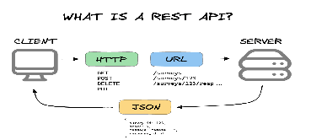
Example of an API
Other Examples of APIs
Social Media APIs: Platforms like Facebook, Twitter, and Instagram provide APIs that allow developers to interact with their services, access user data, and post content.
Payment Gateway APIs: Services like PayPal and Stripe offer APIs that enable developers to integrate payment processing functionality into their applications.
Act fiber net
Jio, Airtel

Slide 8
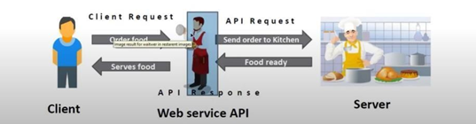
Webservices
What are Webservices?
Web services are software platforms created to provide open, networked machine-to-machine communication.
They provide a standardized way for different applications to exchange data and interact with each other.

Slide 9
Types of Webservices
SOAP (Simple Object Access Protocol).
RESTful (Representational State Transfer)
SOAP Web Service:
SOAP is a protocol for exchanging structured information in web services using XML.
SOAP is a very old and complex technology, and it supports only post requests only.
RESTful Web Service:
RESTful is the latest technology and its supports multiple ways to communicate like XML, Text, HTML, and JSON.
RESTful web services use standard HTTP methods (GET, POST, PUT, DELETE) to perform operations on resources.

Slide 10
Pre-Requisite for the API Request
PARAM = Parameters of the request
Authorization = Login Authorization , Token and some API are completely restricted so in that case we need to pass Authorization
Headers = Receive from server side
Body = Contain all the response
Pre-Request Script = Any script that we want to execute before sending the request
Test = Most important , we add validation here. All other script will also part of this tab
Notes:
I've created a json server in a local host using node js
Steps
install node js
open cmd prompt
after installing node js we can check this in cmd prompt using - npm -version.
After that create a json file which contains user details and save it in json file.
and run the cmd - json-server --watch db.json.
Now the local host resource will be created.

Slide 11
Types of Restful API Service
What is a GET Request?
A GET request is an HTTP method used to retrieve data or resources from a server.
It is one of the most common HTTP methods and is used for reading or retrieving information. Every request will get us response in JSON format.
After getting the response from the API if the status code is 200 , 201 then it mean our request was successful and all other codes mean there is some problem.
Example :
We can see the example using the following URL in Postman
http://localhost:3000/employees

Slide 12
Types of Restful API Service
What is a POST Request?
A POST request is an HTTP method used to submit or send data to a server.
It is commonly used when creating or updating resources on the server.
Anatomy of a POST Request
POST requests consist of:
The HTTP method: POST
The URL (Uniform Resource Locator) or endpoint where the data should be sent.
The payload or data that needs to be included in the request.

Slide 13
Types of Restful API Service
What is a PUT Request?
A PUT request is an HTTP method used to update or replace an existing resource on a server.
It is commonly used when modifying or updating specific data on the server.
Anatomy of a PUT Request
PUT requests consist of:
The HTTP method: PUT
The URL (Uniform Resource Locator) or endpoint of the resource you want to update.
The payload or data that needs to be included in the request.

Slide 14
Types of Restful API Service
What is a DELETE Request?
A DELETE request is an HTTP method used to remove or delete a specific resource on a server.
It is commonly used when you want to delete a specific piece of data or resource.
Anatomy of a DELETE Request
DELETE requests consist of:
The HTTP method: DELETE
The URL (Uniform Resource Locator) or endpoint of the resource you want to delete.

Slide 15
Chain Request API
What is chain request API?
Chain request API, also known as Chained API or Sequential API, is an approach in API development where multiple API requests are executed sequentially in a specific order. It allows you to create a series of API calls where the response from one request is used as input or parameters for the subsequent request.
In a chain request API scenario, the output of one API request becomes the input for the next API request, forming a chain or sequence of dependent requests. This enables you to perform complex workflows or operations that require multiple steps or interactions with different APIs.

Slide 16
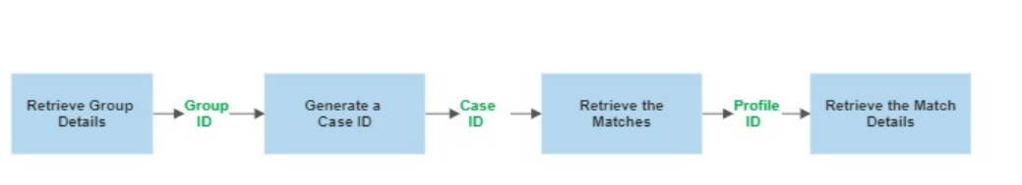
Example of Chain Request API
World Check One APIs
Here, we are going to see the Chain API request using the world check one.
The World Check One is used for Screening an Individual or Entity . The following are the steps
Involved in the screening

Slide 17
Example of Chain Request API
Retrieve Group Details
Retrieve Group Details
Used to retrieve the screening configuration which is configured in the world check Platform.
Generate Case Id
Used to generate a Case Id for the entity or individual which is used for the screening
Retrieve the matches
Used to retrieve the matched for the screened record using the Case Id
Retrieve the Match Details
Used to retrieve the match details for any match.

Slide 18
Thank you

Slide 19
API using Postman

Slide 20
API using Postman
Agenda
What is Postman?
Collections
Import and Export of Postman collections
Workflow
Types of scripts
Run collections using CMD line

Slide 21
What is Postman?
Postman is a popular software tool used by developers for testing, documenting, and interacting with application programming interfaces (APIs). It provides a user-friendly interface that allows developers to make HTTP requests to APIs and receive responses, simulating how an application or system would interact with the API.
With Postman, developers can send various types of requests, such as GET, POST, PUT, DELETE, and more, to an API endpoint. They can also customize headers, parameters, and authentication methods to test different scenarios and verify the behavior of the API.

Slide 22
What is collection?
Benefits of Using Collections:
Discuss the advantages of using collections, such as improved workflow, reusability, and collaboration.
Highlight how collections help streamline the API testing and development process.
Explain how to name and describe the collection appropriately for easy reference.
Import and Export of Postman collections:
Postman provides several options for importing and exporting collections, allowing you to easily share and transfer your collections across different environments or with team members. Here are the import and export options available in Postman:

Slide 23
Importing Collections:
File Import:
Click on the "Import" button in the Postman app.
Select the "File" tab.
Choose the collection file you want to import (supported formats include JSON, cURL, and Postman Collection v1 and v2).
Click "Import" to import the collection into Postman.
Link Import:
Click on the "Import" button in the Postman app.
Select the "Link" tab.
Provide the URL or link to the collection file you want to import.
Click "Import" to import the collection into Postman.

Slide 24
Exporting Collections:
File Export:
Open the collection you want to export in Postman.
Click on the "..." (ellipsis) button at the top-right corner of the collection pane.
Select "Export".
Choose the desired format for exporting the collection (JSON, cURL, or Postman Collection v2).
Save the exported file to your local system.
Link Sharing:
Open the collection you want to share in Postman.
Click on the "Share" button at the top-right corner of the collection pane.
Choose the desired sharing option (Public, Hidden Link, or Postman Team/Enterprise).
Copy the generated link and share it with others.

Slide 25
Whaqt is

